Slide 1
Women rights in Pakistan
NAME : MASOOMA WIGHIO
Like: education, profession etc
DATE: 30/6/2024

Slide 2
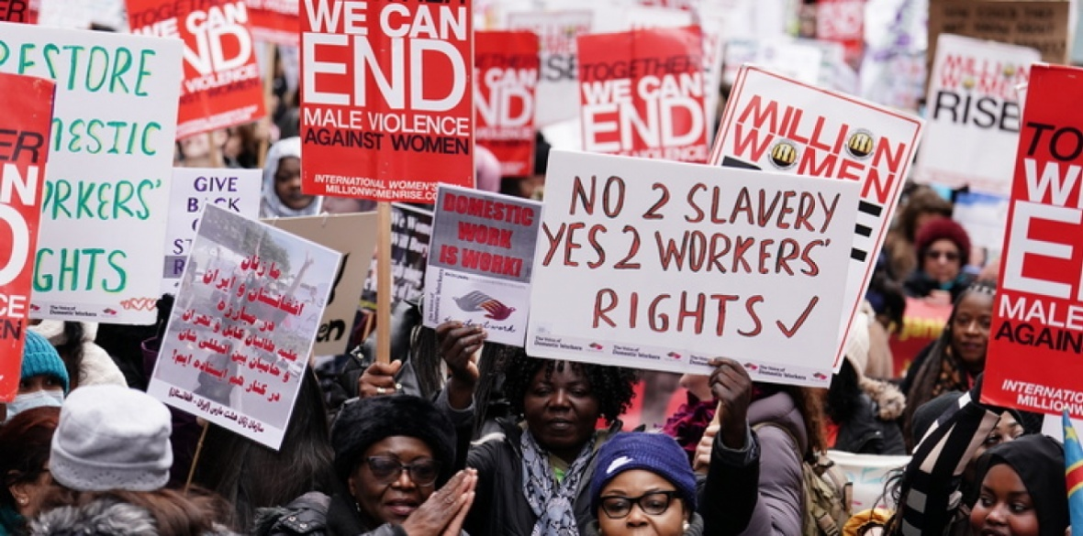

Slide 3

SYMBOL REPRESENTSTION
These include the right to live free from violence and discrimination; to enjoy the highest attainable standard of physical and mental health; to be educated; to own property; to vote; and to earn an equal wage.

Slide 4


Slide 5
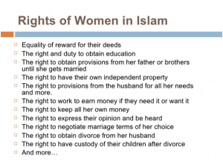
List of women rights

Slide 6
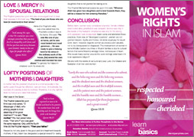

Slide 7
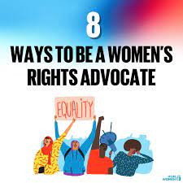

Slide 8
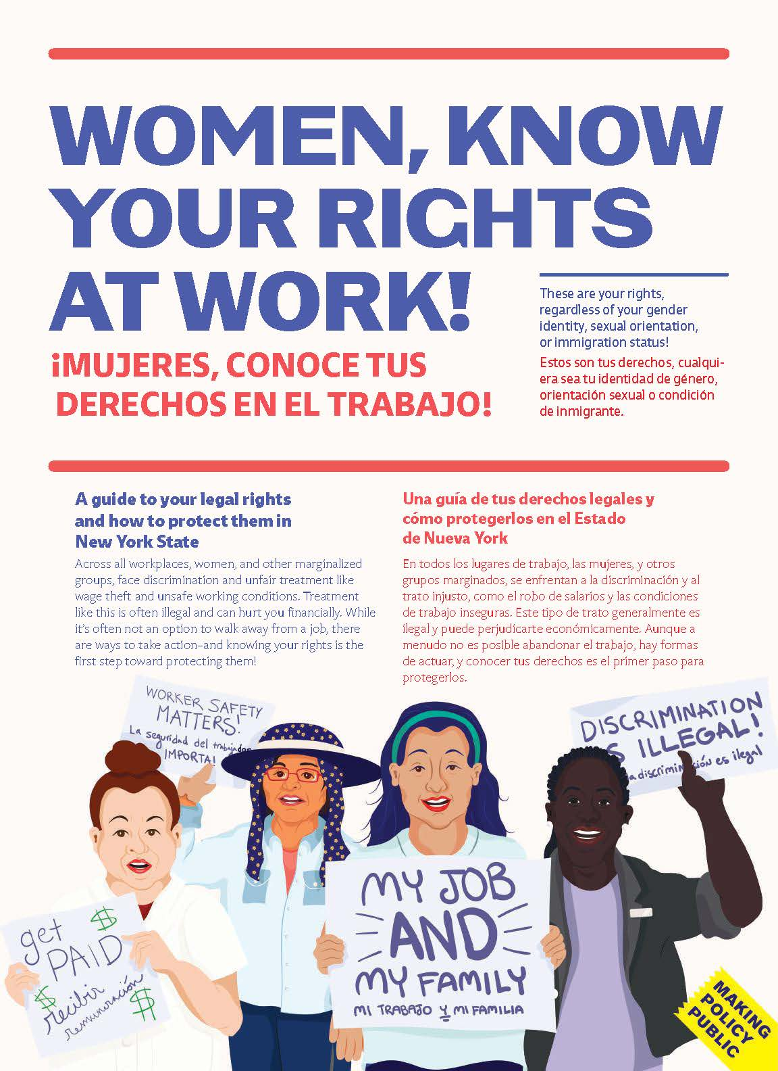

Slide 9
What should government of Pakistan do for women rights in Pakistan
?

Slide 10


